Slide 1
WALMART SALES ANALYSIS
Using Python , SQL-Server And Power Bi

Slide 2

Content
Project Overview
Project Architecture Diagram
Data cleaning and processing
Data insights
Power BI Dashboards

Slide 3
Project Overview
The project focuses on analyzing Walmart’s sales data using Python, SQL- server and Power BI.
Objective: The goal is to clean, preprocess and visualize the data to generate insight that can help in decision-making.
Python:
Used for data cleaning, preprocessing and visualization.
Libraries like Pandas, NumPy, Matplotlib, and Seaborn were utilized for data manipulation and visualization.
SQL-Server:
Used to store and manage the dataset in a relational database.
Enabled efficient querying and extraction of data for analysis.
Power BI:
Power BI was used for data visualization, dashboard creation, and interactive reporting.

Slide 4
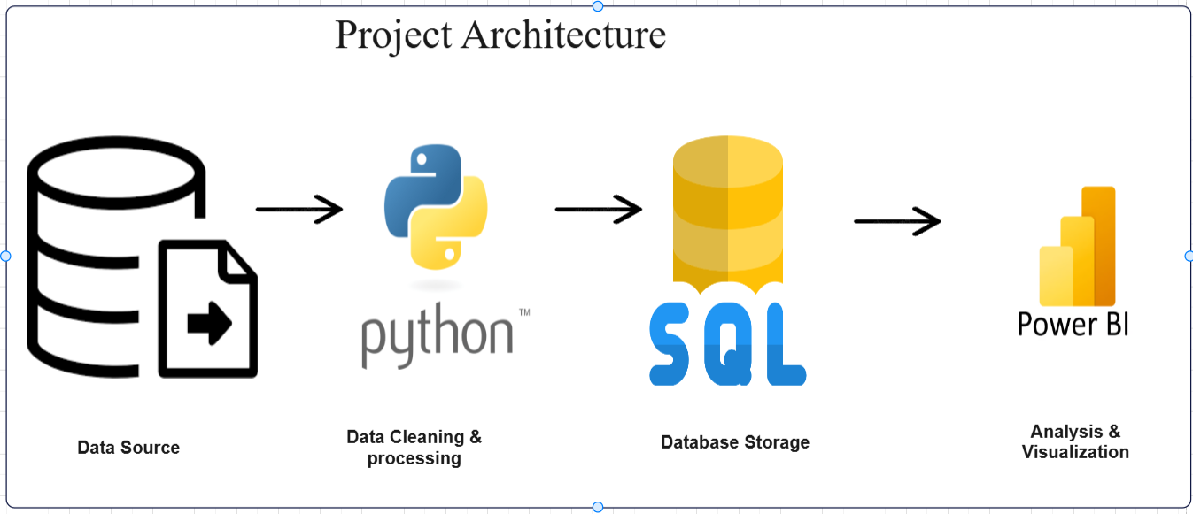
Dataset: The dataset used in this project was collected from open source, containing detailed information about sales transactions. It includes 18 columns, such as InvoiceID, Branch, City, Category, Unit_Price, Quantity, Date, Time, Payment_Method, Profit_Margin, Total_Revenue, Profit, Profit_per_unit, Year, Month, DayOfWeek, and Day.
BEFORE CLEANING:
10051 rows and 11 columns
AFTER CLEANING:
10000 rows and 18 columns

Slide 5
Data cleaning and processing
Handling Missing Values:
First, I identified missing values in columns like unit_price and quantity. For numerical columns, I filled missing values with the mean, and for categorical columns, I used the mode.
Creating New Columns:
Created new columns like “Revenue”(unit_price * quantity),”Profit”(Revenue*profit_margin) and “profit_per_unit”(profit*quantity).
Data Transformation:
Finally, I transformed the Unit_Price column by removing the $ sign and converting it into a numerical format.
Converted “Date” to a datetime format for easier analysis.

Slide 6
Data Insights
Revenue and Profit Trends:
Health and beauty products have the highest unit price and contribute significantly to total revenue and profit.
Electronic accessories have a lower unit price but may have higher sales volume, contributing to overall profitability.
Geographical Performance:
Compare sales and profitability across cities (e.g., San Antonio, Harlingen, Haltom City) to identify high-performing and underperforming regions.
Category Performance:
Health and beauty and Home and lifestyle categories show higher profit margins compared to Electronic accessories.
Focus on promoting high-margin categories to boost overall profitability.
Payment Method Analysis:
Ewallet and Cash are popular payment methods. Credit card usage may vary by location or category.
Investigate if payment methods influence customer ratings or purchase behavior.

Slide 7
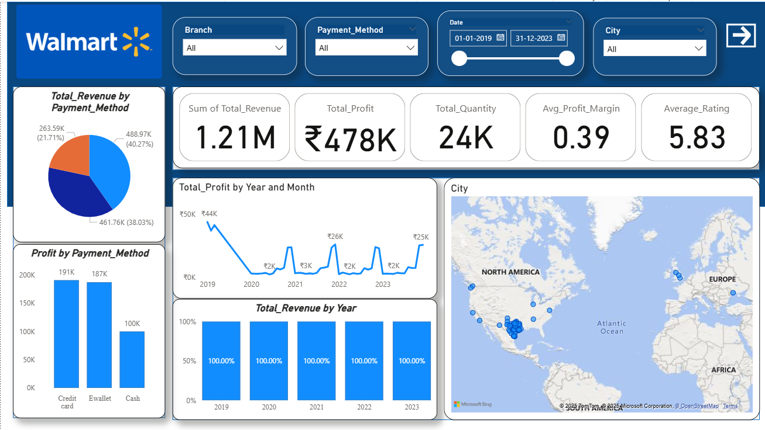

Slide 8
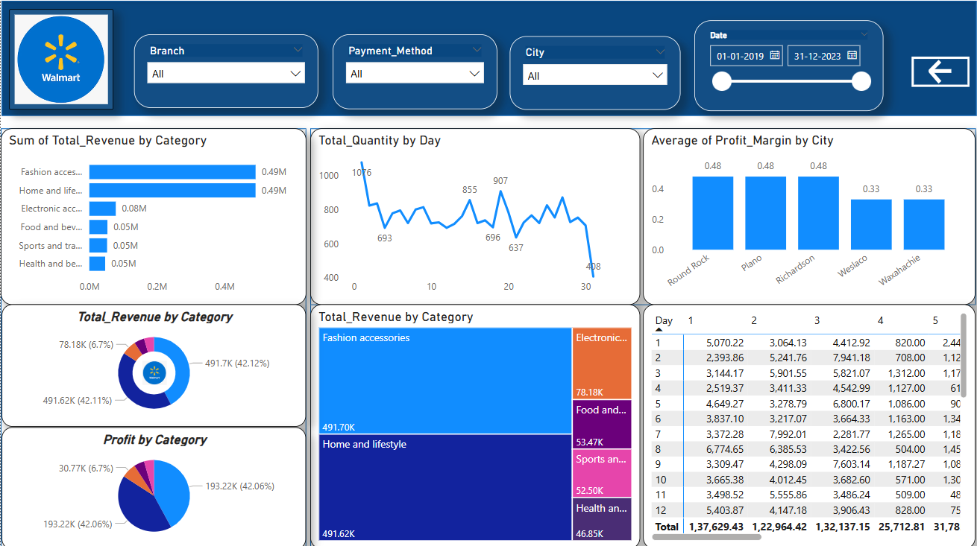

Slide 9
THANK YOU

